Slide 1

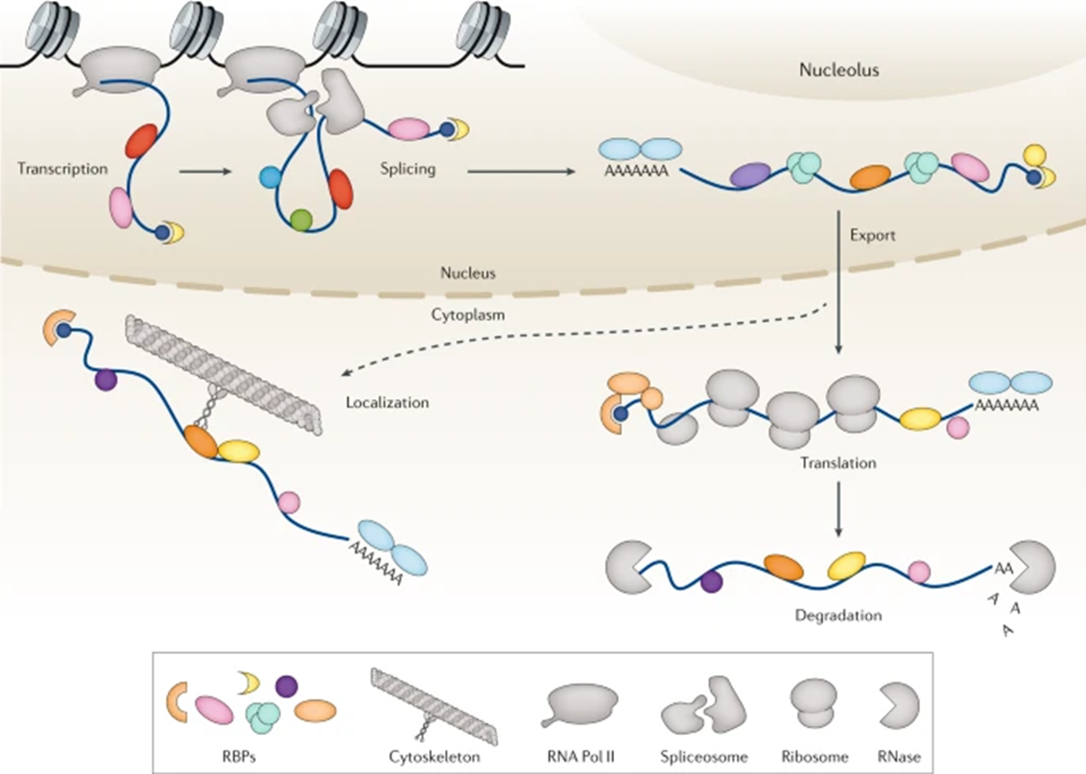
Biological background
RDeep: RNA dependent and RNA binding
Control RNA life, function, efficiency = house-keeping role
Malfunction underlies origin of many diseases
Promising novel therapeutic targets
F. Gebauer et. al (2020). RNA-binding proteins in human genetic disease

Slide 2

Experimental setup
A549 cells cultured and lysed
One sample treated with RNase, one untreated control
Three replicates of each sample
Sucrose gradient Dividation into 25 fractions
Mass spectrometry analysis
dataframe with 3680 proteins and their protein amounts

Slide 3
Procedure
3 Normalization Methods
-Mean-Value-Method
-Z-Transformation
-Min-Max-Scaling
Reproducibility
Gaussian fit
Only visulization
Line graphs
Parameters
t-test
K-means
Regression analysis
Results
Comparison with Database
Raw
Data
RDeeps

Slide 4
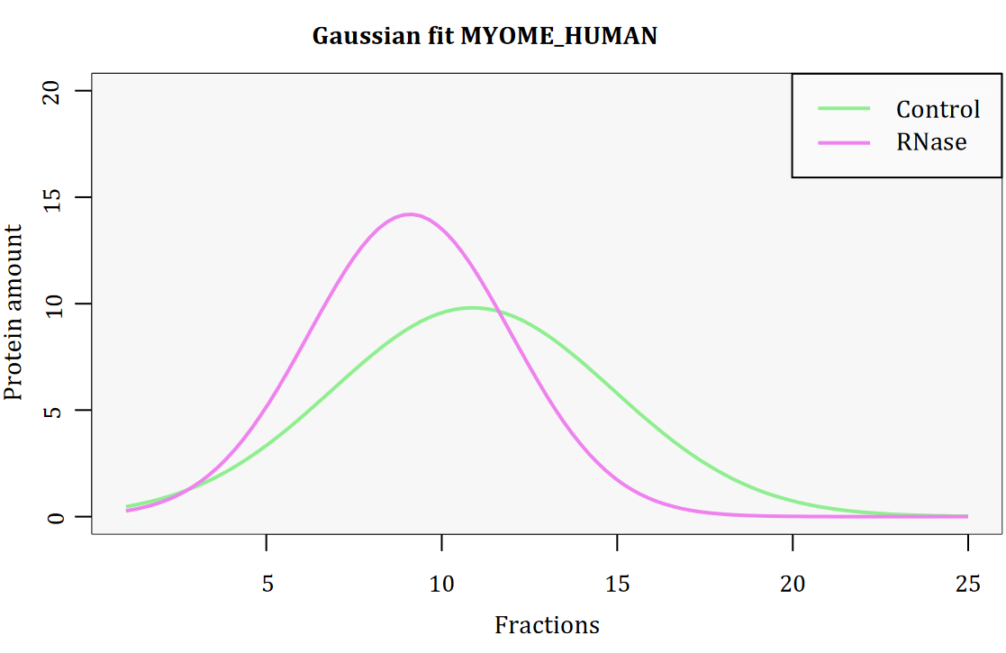
Gaussian fit
list of parameters for all proteins
Plotted gauss curves
For better comparison Control and RNase in one plot
Not used for further analysis
Notes:
Gaussian fit was successful
-> reason why we

Slide 5
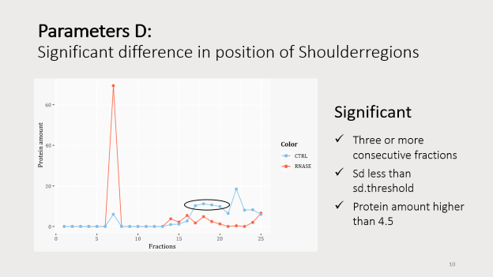
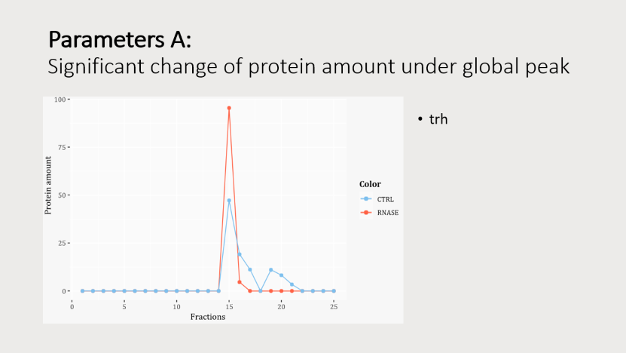
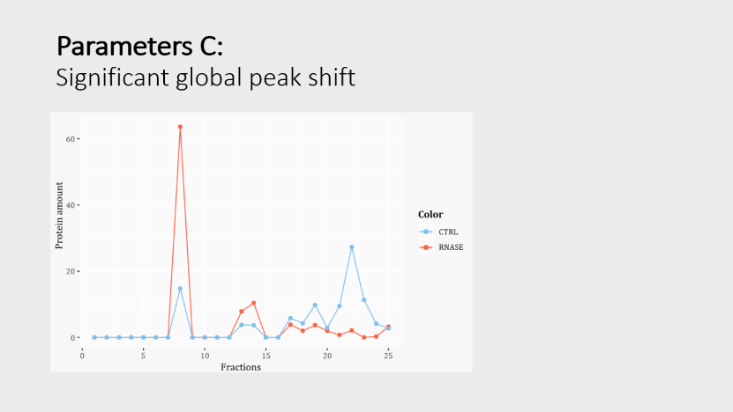
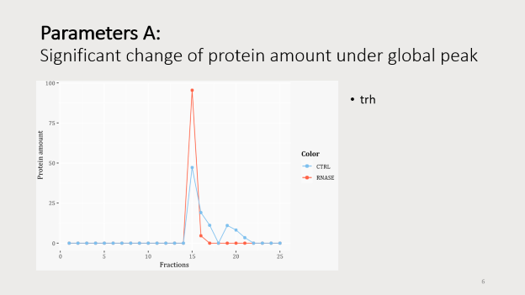
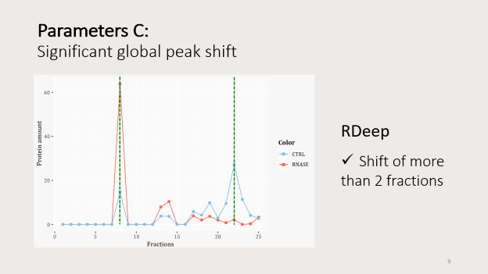
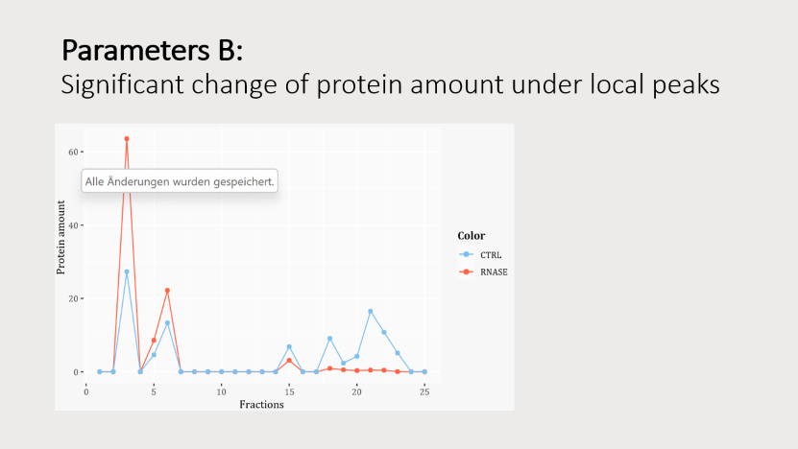

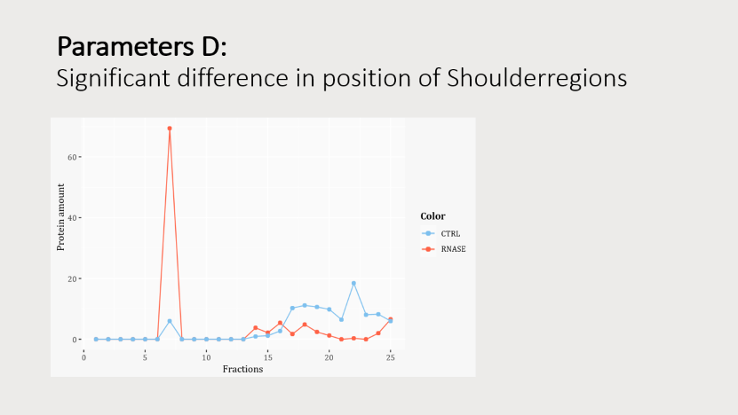
Data characterization via Parameters

Slide 6
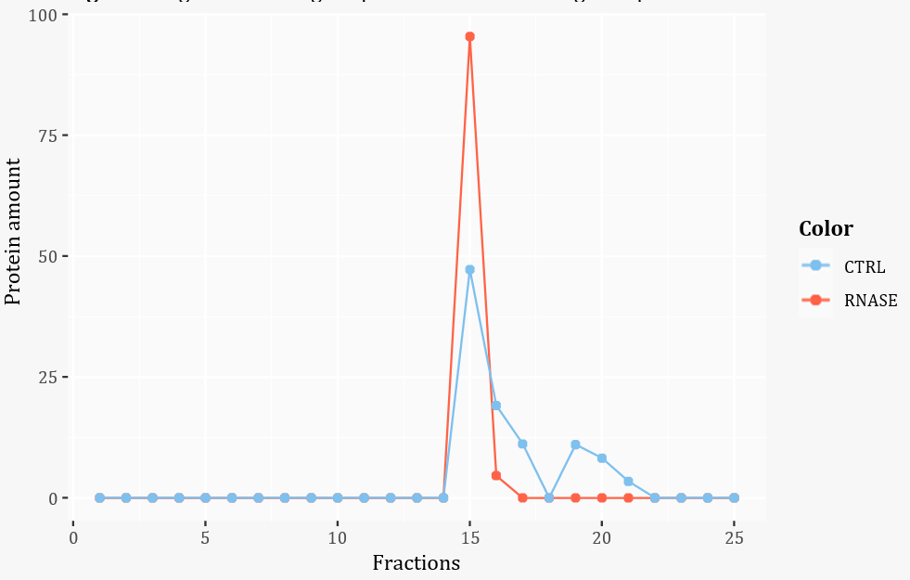
Parameters A: Significant change of protein amount under global peak
trh

Slide 7
T- test

Slide 8
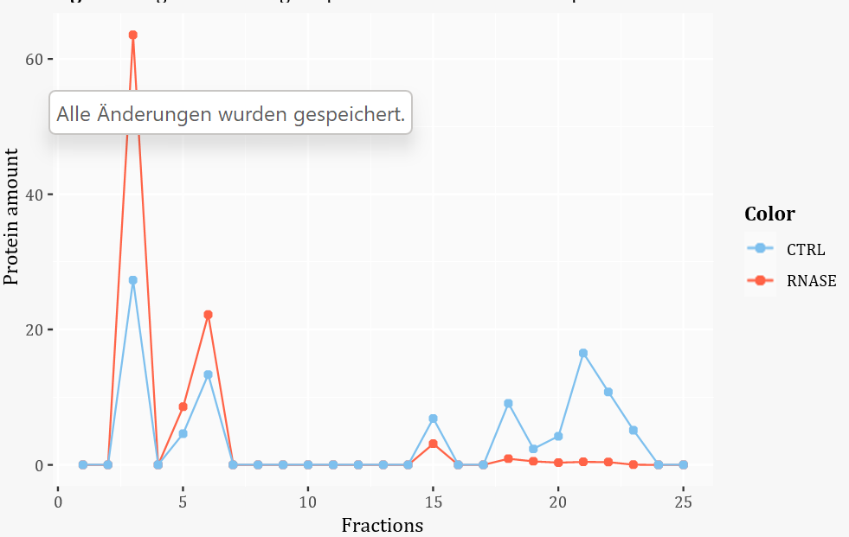
Parameters B: Significant change of protein amount under local peaks

Slide 9
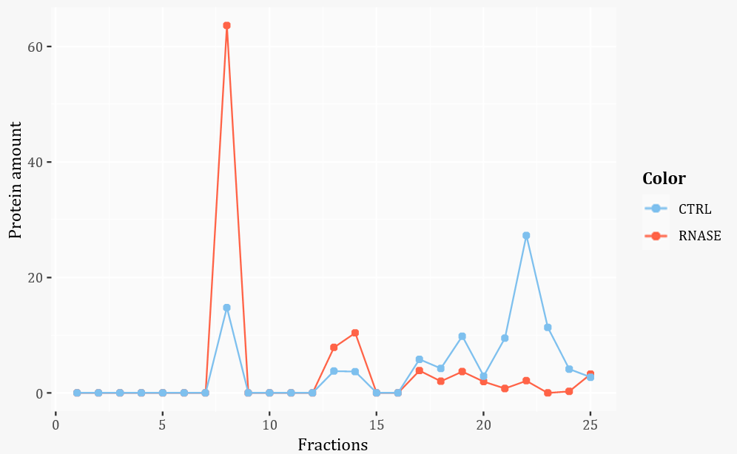
Parameters C: Significant global peak shift
RDeep
Shift of more
than 2 fractions
Notes:
Parameter C: Significant fraction‑shift of global peak
The third parameter focuses on the x‑axis depicting the fractions. If the fraction of the global peak in either the Control or RNase sample differs more than two fractions in the positive or negative x‑ direction compared to the other sample, the protein is defined as RNA‑dependent. It lost or gained an interaction partner due to the RNase treatment.
Just a significant shift is enough to be classified as RDeep.
All proteins that had two positive parameters and all proteins that had solely a global shift were classified as RNA‑dependent.

Slide 10
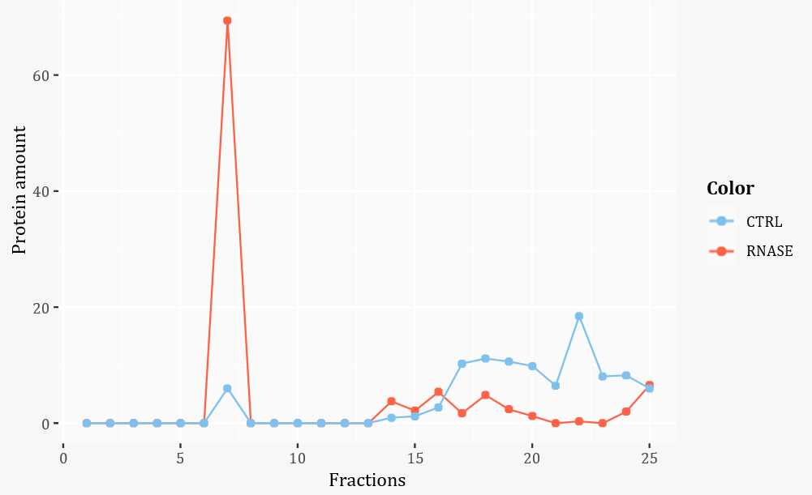
Parameters D: Significant difference in position of Shoulderregions
Significant
Three or more consecutive fractions
Sd less than sd.threshold
Protein amount higher than 4.5
Notes:
at last, it is observed if shoulderregions occur or disappear after the RNase treatment. A shoulderregion contains more than 2 consecutive fractions with a sd less than the sd.threshold. In contrast to the local peak identification the fractions with small fluctuations are sorted. Of interest are those fractions belonging to shoulderregions which either occur in the Control or RNase sample but not in both. Often parts of the shoulderregions are overlapping, resulting in shoulderregions of interest with less than 3 consecutive fractions. So, a shoulderregion of interest is only significant if it has three or more consecutive fractions.

Slide 11
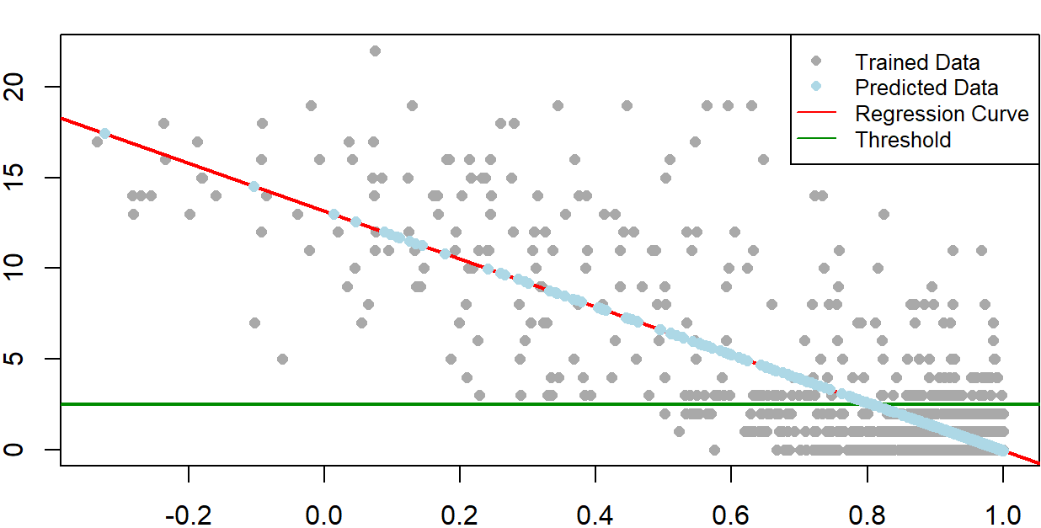
Linear Regression analysis
Independent Variable
Pearson Correlation
Dependent Variable
Parameters: R² = 0.43
Global Shift amount: R² = 0.66
Global Shift amount [fraction]
Threshold
= Shift of more than 2 fractions
Pearson Correlation between Control and RNase
Notes:
The linear regression models the mathematical relationship between a dependent variable and an independent variable.
To analyze the model two values have to be taken into account. At first, if the p‑value is above 5 %, the model must be discarded.
Furthermore, the R‑squared value describes the model’s accuracy representing the proportion of the variance in the dependent variable that can be explained by the independent variables.
Tow regression models are generated, both working with the pearson correlation between the Control and RNase protein amounts as the independent variable. The two models differ in their dependent variable. One uses the result of our four parameters, while the other uses the global shift amount in fractions. They are trained with 80 % of our dataset, so a prediction can be made for the remaining 20 %.
The two already described regression models showed both a p‑value below 0.05 and therefore they could be used for further analysis. The highest R‑squared values were detected for the z‑transformed data: the model based on the parameters showed a R‑squared value of 0.43, while in the model using the global shift amount the R‑squared value was 0.66.
The model with the higher R‑squared value is visualized in Figure 8. Each protein is depicted as a dot. As expected, the majority of the trained data, marked in grey, showed a high correlation and a shift under 2 fractions. On the other hand, those with a small correlation had a shift upwards of 2 fractions. As already decided for the parameter Significant fraction‑shift of global peak: a protein was classified as RNA‑dependent protein if it had a shift higher than two fractions. The threshold is marked as a green line in the plot.

Slide 12
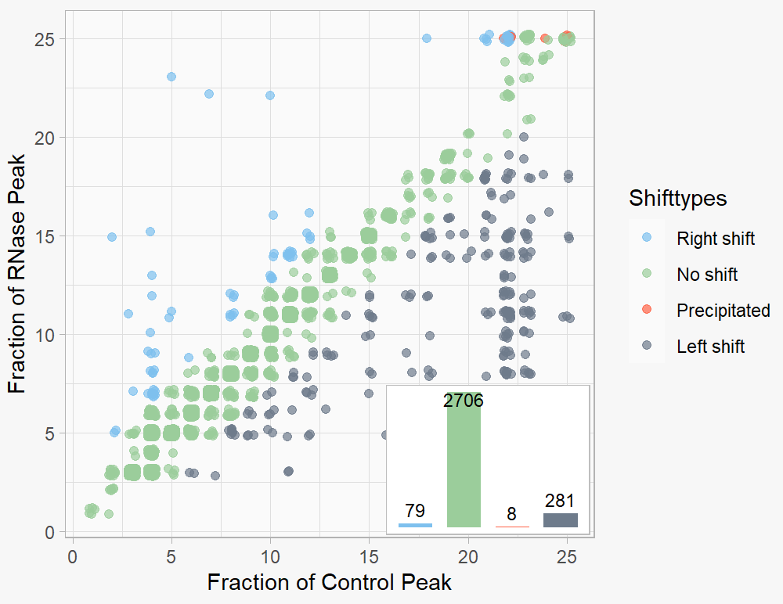
Global Shifting behavior
mvm
 | mvm | zt | mms
True Positives | 301 | 295 | 302
False Positives | 64 | 52 | 65
True Negatives | 2149 | 2161 | 2148
False Negatives | 540 | 546 | 539
Precipitated
Global peak in fraction 25
Total protein amount of 100 has to split between fraction 23, 24 and 25
Notes:
Die Tabellen sind nur zur Genauigkeit des shifts, nicht der shifttypes!!!!
Using just parameter C (global shift), we were able to characterize the shifttype, so whether the peaks show no shift, a right shift, a left shift, or are precipitated. The graph 5 visualizes our results for MVM. Using only parameter C we were able to identify 368 RNA‑dependent Proteins with MVM, 349 with z‑transformation and 320 with MMS.
The local peakfinder cannot find local maxima at the boundaries (fraction 1 and fraction 25) because they have only one neighbor fraction. A local peak at the boundary has to fulfill following requirements. Firstly, it has to have a higher y‑value than the two succeeding fractions. Secondly, the protein amount of those three fractions has to be bigger than 10. Smaller protein amounts are not relevant enough. Also precipitated proteins are not described by the parameters and have to be identified separately. They have a global peak in fraction 25 and their total protein amount of 100 has to be split between fraction 23, 24 and 25.

Slide 13
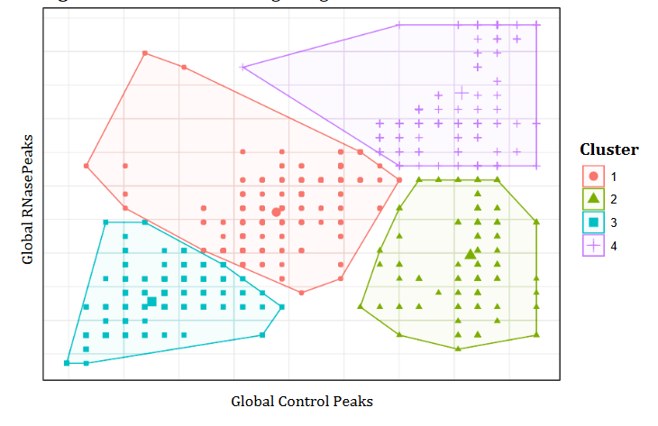
K-means clustering
 | mvm | zt | mms
True Positives | 158 | 153 | 157
False Positives | 2 | 2 | 2
True Negatives | 2211 | 2211 | 2211
False Negatives | 683 | 688 | 684
 | mvm | zt | mms
FNR | 0.8121 | 0.8181 | 0.8133
FPR | 0.0009 | 0.0009 | 0.0009
Precision | 0.9875 | 0.9871 | 0.9874
Notes:
Vorsicht bei Protein Zahlen!!! Nicht alle Proteine konnten verglichen werden (Struktur der Vorstellung?

Slide 14
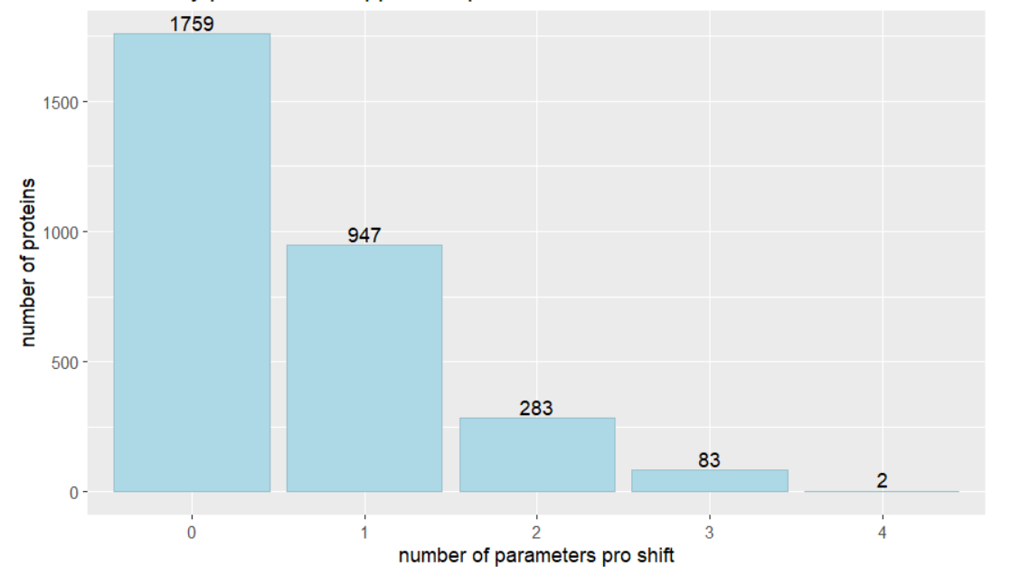
Parameters

Slide 15
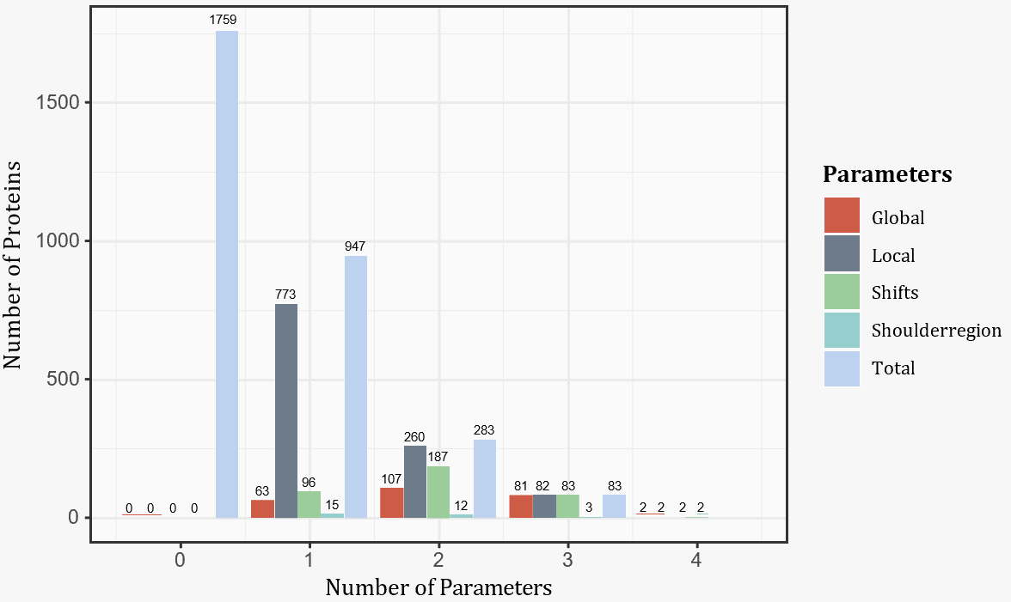
Parameters
 | mvm | zt | mms
True Positives | 356 | 380 | 316
False Positives | 105 | 85 | 77
True Negatives | 2108 | 2128 | 2136
False Negatives | 485 | 461 | 525
 | mvm | zt | mms
FNR | 0.5767 | 0.5482 | 0.6243
FPR | 0.0474 | 0.0384 | 0.0348
Precision | 0.7722 | 0.8172 | 0.8041

Slide 16
Which normalization method is the best?
Global shift rates
K-means rates
Parameters rates
 | mvm | zt | mms
FNR | 0.6421 | 0.6492 | 0.6409
FPR | 0.0289 | 0.0235 | 0.0294
Precision | 0.8247 | 0.8501 | 0.8229
 | mvm | zt | mms
FNR | 0.8121 | 0.8181 | 0.8133
FPR | 0.0009 | 0.0009 | 0.0009
Precision | 0.9875 | 0.9871 | 0.9874
 | mvm | zt | mms
FNR | 0.5767 | 0.5482 | 0.6243
FPR | 0.0474 | 0.0384 | 0.0348
Precision | 0.7722 | 0.8172 | 0.8041
→ z-Transformation/ Mean-Value-Method
Notes:
With only a few exceptions, mvm allways has the best FNR, FÜR and Precision

Slide 17
Which analysis method is the best?
Global shift rates
K-means rates
Parameters rates
 | mvm | zt | mms
FNR | 0.6421 | 0.6492 | 0.6409
FPR | 0.0289 | 0.0235 | 0.0294
Precision | 0.8247 | 0.8501 | 0.8229
 | mvm | zt | mms
FNR | 0.8121 | 0.8181 | 0.8133
FPR | 0.0009 | 0.0009 | 0.0009
Precision | 0.9875 | 0.9871 | 0.9874
 | mvm | zt | mms
FNR | 0.5767 | 0.5482 | 0.6243
FPR | 0.0474 | 0.0384 | 0.0348
Precision | 0.7722 | 0.8172 | 0.8041
Highest precision → kmeans
BUT: high false negative Rate
Notes:
Wir sehen aber auch dass die Raten der Parameter nicht so schlecht sind
Und enorme FNR

Slide 18
Which analysis method is the best?
Global shift proteins
K-means proteins
Parameters proteins
 | mvm | zt | mms
True Positives | 301 | 295 | 302
False Positives | 64 | 52 | 65
True Negatives | 2149 | 2161 | 2148
False Negatives | 540 | 546 | 539
 | mvm | zt | mms
True Positives | 158 | 153 | 157
False Positives | 2 | 2 | 2
True Negatives | 2211 | 2211 | 2211
False Negatives | 683 | 688 | 684
 | mvm | zt | mms
True Positives | 356 | 380 | 316
False Positives | 105 | 85 | 77
True Negatives | 2108 | 2128 | 2136
False Negatives | 485 | 461 | 525
Most true RNA dependent Proteins → Parameters
Notes:
Raten der Parameter sind auch nicht so schlecht sind

Slide 19
“New Proteins”
 | Name | Rdeep according to parameters | Shift according to parameters zt | Shift according to parameters mms
 |  | MVM | Z-Transformation | MMS
1 | OREX_HUMAN | 0 | 0 | 0
2 | DFFB_HUMAN | 0 | 0 | 0
3 | TISB_HUMAN | 0 | 0 | 0
4 | GDC_HUMAN | 0 | 0 | 0
5 | NAPSA_HUMAN | 0 | 0 | 0
6 | GGYF1_HUMAN | 0 | 0 | 0
7 | RNH1_HUMAN | 1 | 1 | 1
8 | MIS_HUMAN | 0 | 0 | 0
9 | CTDS2_HUMAN | 0 | 0 | 0
10 | MT2_HUMAN | 0 | 0 | 0
11 | SC6A4_HUMAN | 0 | 0 | 0
12 | DLGP3_HUMAN | 1 | 1 | 1
13 | LRP4_HUMAN | 0 | 0 | 0
14 | PEX2_HUMAN | 0 | 1 | 0
15 | APLP2_HUMAN | 0 | 0 | 0
16 | TAF12_HUMAN | 0 | 0 | 0
17 | VMAT1_HUMAN | 1 | 0 | 1
18 | PHIP_HUMAN | 0 | 0 | 0
19 | KLC3_HUMAN | 0 | 0 | 0
20 | MTU1_HUMAN | 0 | 0 | 0
21 | NXT1_HUMAN | 1 | 1 | 1
total | 21 | 4 | 4 | 4

Slide 20

Outlook
We achieved:
Numerous RDeeps verified
Up to 5 new RDeeps
What has to be done next:
Investigation of cellular function
Research if malfanction is related to disease
medical application

